Slide 1


SES PROJECTS
DESIGN OF A MECHANICAL SYSTEM

Slide 2

What are your next steps?
Understand the requirements, i.e. understanding the purpose of design.
4
Analyze and evaluate the Design Mechanism- Shortlist and analyze various possible mechanisms for the machine.
3
2
Analysis of Forces and Design of Elements- Material analysis and selection.
1
Creation of detailed Mechanical Drawings- e.g. using software such as Inventor.
Notes:
Notes to presenter:
What steps will you be taking as a result of this learning experience?
Did you learn from any failed experiences? How will you do things differently?
What advice will you give to others so they can learn from your experiences?
How can you share what you learned with a real-world audience?
Some examples of next steps might be:
After delivering my first persuasive presentation, I am thinking about joining the debate team.
After making my first film, I’m considering entering it in our school film festival or local film festival.
After connecting with this career expert, I’d like to do some research on that career field because it sounds interesting to me.
This SmartArt allows you add images and text to help outline your process. If a picture is worth a thousand words, then pictures and words should help you communicate this reflection on learning perfectly! You can always click on Insert>SmartArt to change this graphic or select the graphic and click on the Design contextual menu to change the colors.
Feel free to use more than one slide to share your next steps. It also helps to add some video content to explain your message.

Slide 3
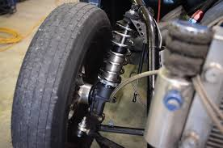
Design of a Mechanical System: A shock absorber.
What are shocks? Shocks, also referred to as the shock absorbers, are a key component of the suspension system. They control the impact and rebound movement of your vehicle's springs and suspension, ensuring that the vehicle's tires remain in contact with the road surface at all times.
Notes:
Notes to presenter:
Description of what you learned in your own words on one side.
Include information about the topic
Details about the topic will also be helpful here.
Tell the story of your learning experience. Just like a story there should always be a beginning, middle and an end.
On the other side, you can add a graphic that provides evidence of what you learned.
Feel free to use more than one slide to reflect upon your process. It also helps to add some video of your process.

Slide 4
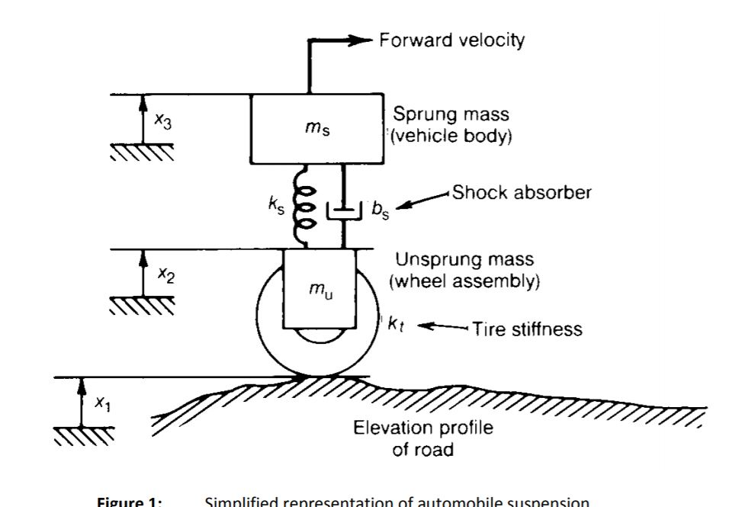
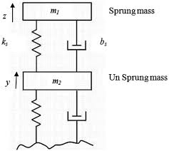
A Shock Absorber- Free Body Diagram.
* FBD- This is a graphical illustration used to visualize the applied forces, moments, and resulting reactions on a body in a given condition.
* Sprung mass is mass that is suspended by a car’s suspension. Its everything that would move down and up if a giant hand came out of the sky and pressed the car’s roof down. That includes the body, chassis, engine, gearbox, seats, passengers and everything else around them.
* The unsprung mass of a vehicle is the mass of the suspension, wheels or tracks, and other components directly connected to them.

Slide 5
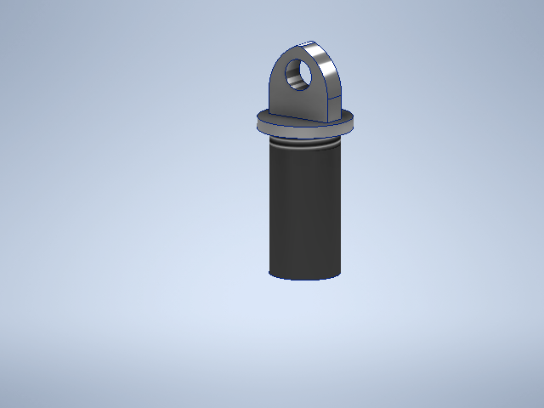
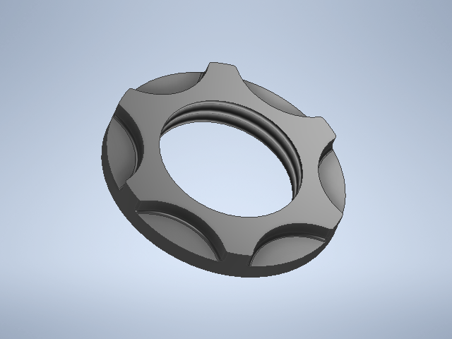
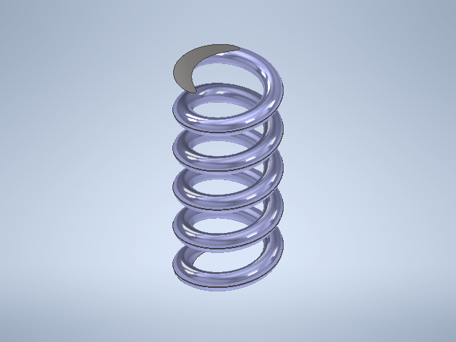
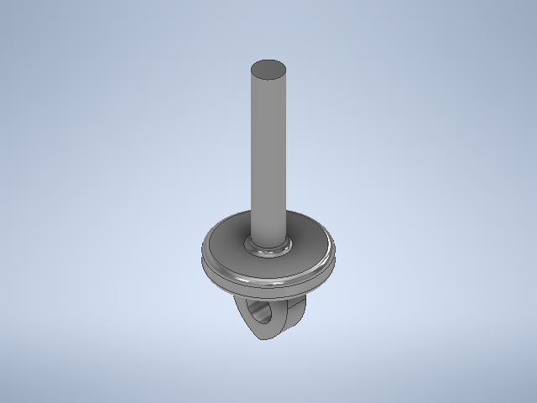
Software used: Autodesk Inventor- Parts

Slide 6
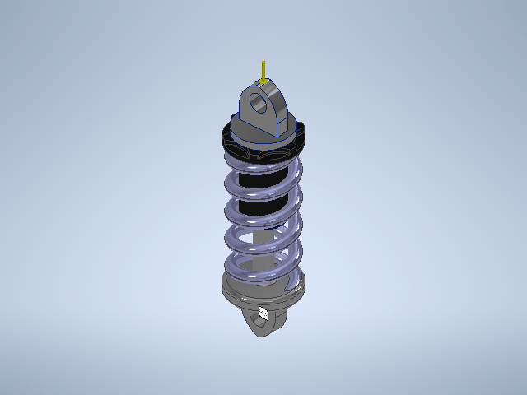
Software used: Autodesk Inventor- Assembly

Slide 7
Design of a Mechanical System.
STRESS ANALYSIS

Slide 8
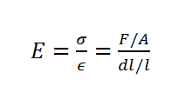
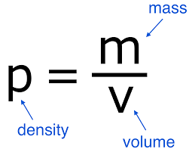
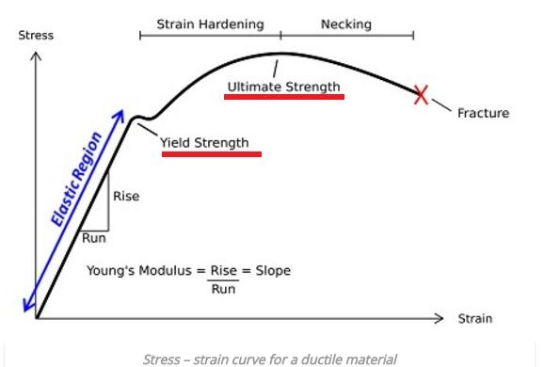
Software used: Autodesk Inventor- Stress Analysis.
Density: This is a measure of mass per unit of volume.
Yield strength is the stress at which a predetermined amount of permanent deformation occurs.
Ultimate Tensile Strength is the maximum stress that a material can withstand while being stretched or pulled before failing or breaking.
Young’s Modulus is a measure of the ability of a material to withstand changes in length when under lengthwise tension or compression. In essence, it is the stiffness of a material. In other words, it is how easily it is bended or stretched.
Notes:
Density is a measure of how compact the mass in a substance or object is.

Slide 9
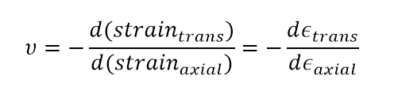
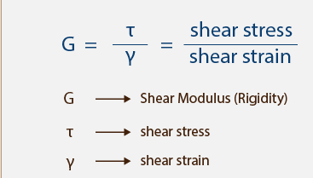
Software used: Autodesk Inventor- Stress Analysis.
Poisson’s Ratio measures the deformation in the material in a direction perpendicular to the direction of the applied force.
Shear Modulus or Modulus of rigidity: This is the measure of the rigidity of the body, given by the ratio of shear stress to shear strain.
Notes:
Density is a measure of how compact the mass in a substance or object is.

Slide 10
Software used: Autodesk Inventor- Stress Analysis.
Engineering components should be designed to withstand working loads without yielding. This is a very simple matter if only one principal stress is involved. When a ductile material is subjected to a simple axial loading, it is found that beyond the elastic limit, stress is no longer proportional to strain, i.e. the material yields. Therefore components from that material should be designed to operate below the yield point.
For components subjected to more than one principal stress such as pressure vessels, rotating discs etc., the no-yielding design problem becomes complicated. It is therefore important to find some criteria based on stresses, strains or strain energy in the complex stress system which can be related to a simple axial condition.
There are four accepted theories of failure (yield criteria):
Maximum shear stress theory - Also called Tresca’s yield criterion.
Shear strain energy theory - Also called Von Mises yield criterion.
Maximum principal stress theory - Also called Rankine’s yield criterion.
Maximum principal strain theory - Also called St. Venant’s yield criterion.

Slide 11
Software used: Autodesk Inventor- Stress Analysis.
To carry out stress analysis, i.e. set up Simulation Environment on an Engineering component, one needs to do the following on the tree:
Assign Material(s).
Put Constraints, i.e. Fixed, Pin and Frictionless- Hold it at one point so that one can load other position(s).
Load- Forces, Moments, Pressure, Bearing etc.
Gravity
Contacts (For Assemblies)- How two parts connect to each other. Typically how two plates are bolted together.

Slide 12
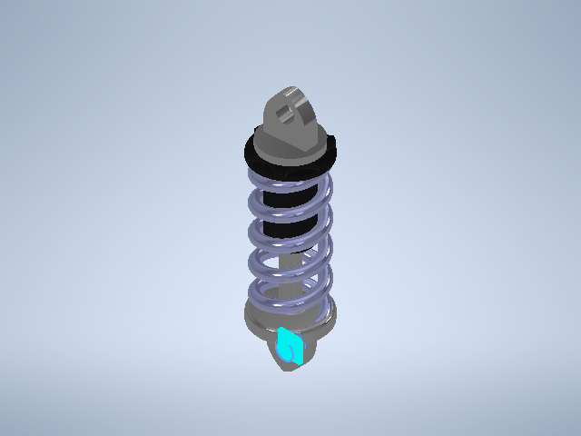
Software used: Autodesk Inventor- Stress Analysis (Constraints).

Slide 13
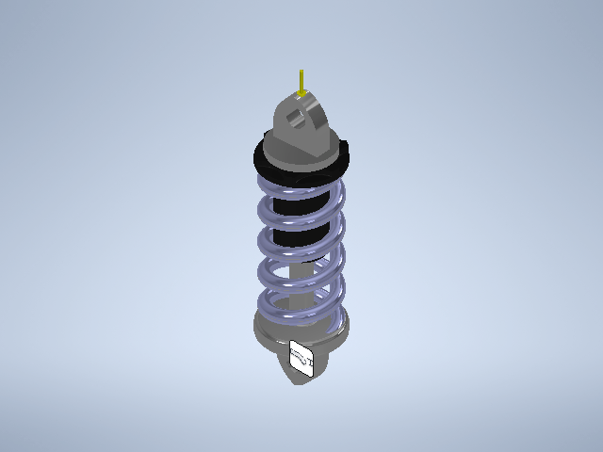
Software used: Autodesk Inventor- Stress Analysis (Gravity Load).

Slide 14
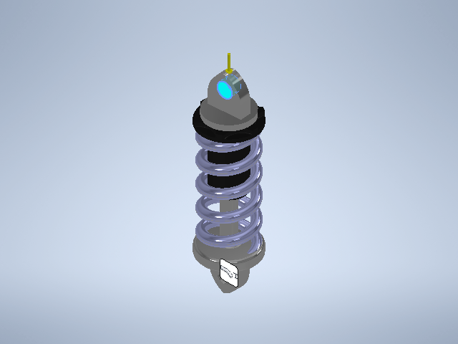
Software used: Autodesk Inventor- Stress Analysis (Bearing Load).

Slide 15
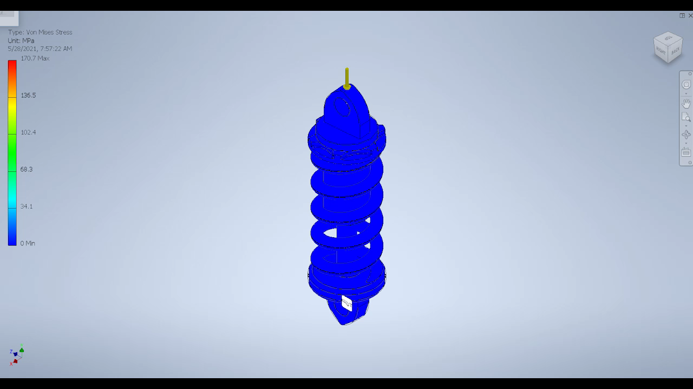
Software used: Autodesk Inventor- Animation.

Slide 16
Software used: Autodesk Inventor- Stress Analysis.
In our case, we are going to look at:
Von Mises Stress.
1st Principal Stress.
3rd Principal Stress.
Aside from stresses, we are also going to see:
How much the component is displaced (Displacement).
How safe our component is on application of load (Safety Factor).

Slide 17
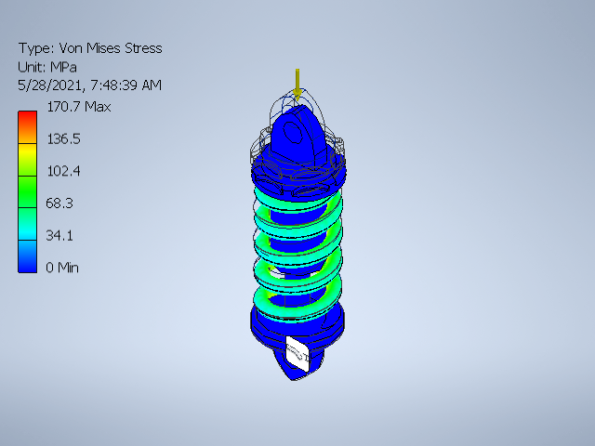
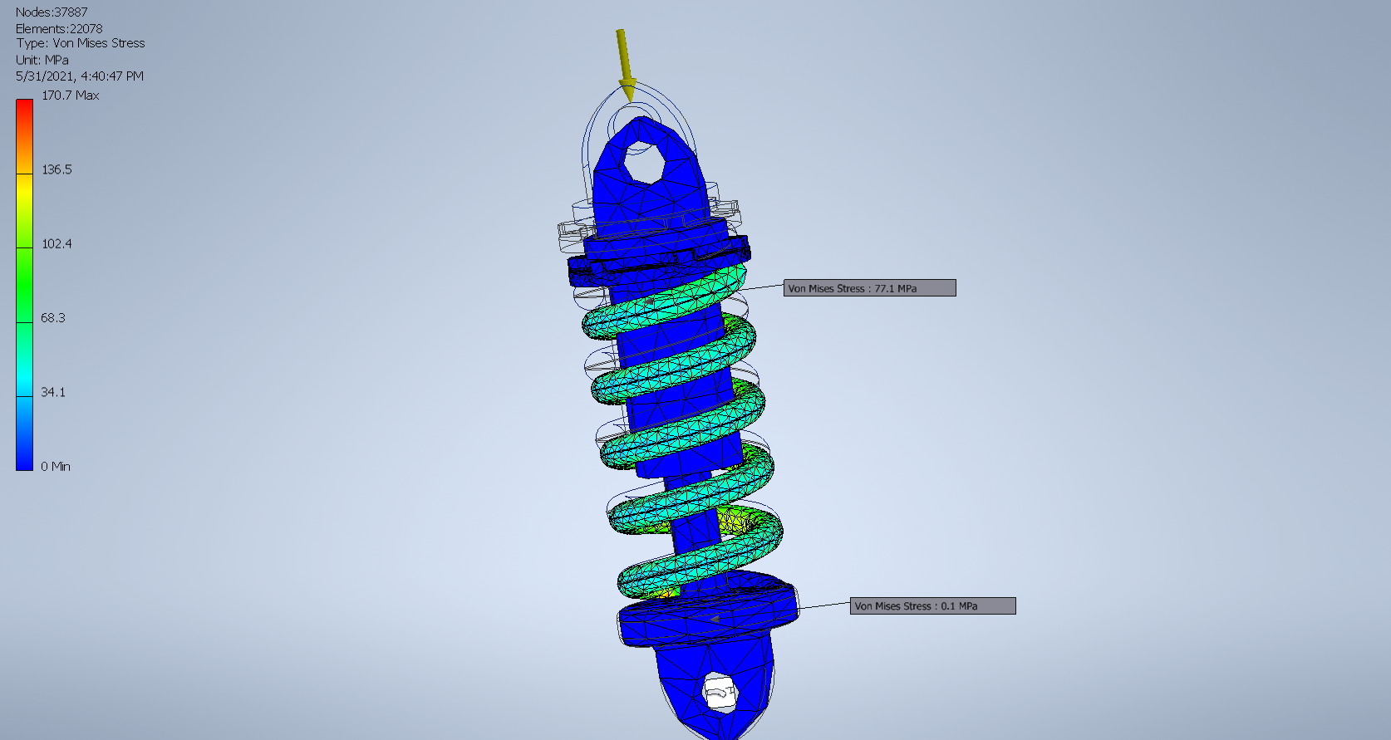
Software used: Autodesk Inventor- Stress Analysis (Von Mises Stress).

Slide 18
Software used: Autodesk Inventor- Stress Analysis (Von Mises Stress).
Von Mises stress is a value used to determine if a given material will yield or fracture. It is mostly used for ductile materials, such as metals. The von Mises yield criterion states that if the Von Mises stress of a material under load is equal or greater than the yield limit of the same material under simple tension then the material will yield. Von Mises stress only considers distortion energy (change in shape) and not dilatational energy (change in volume).

Slide 19
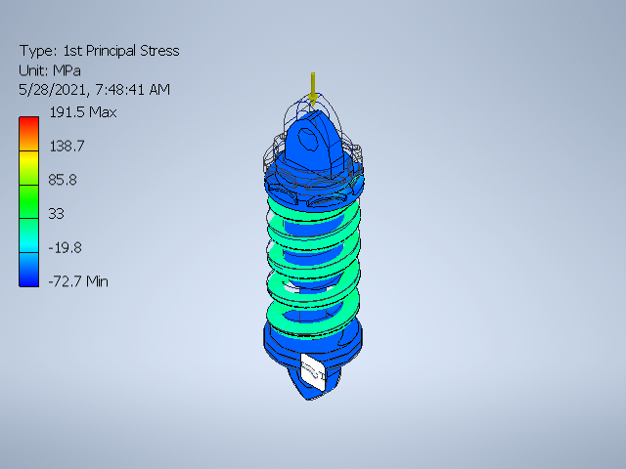
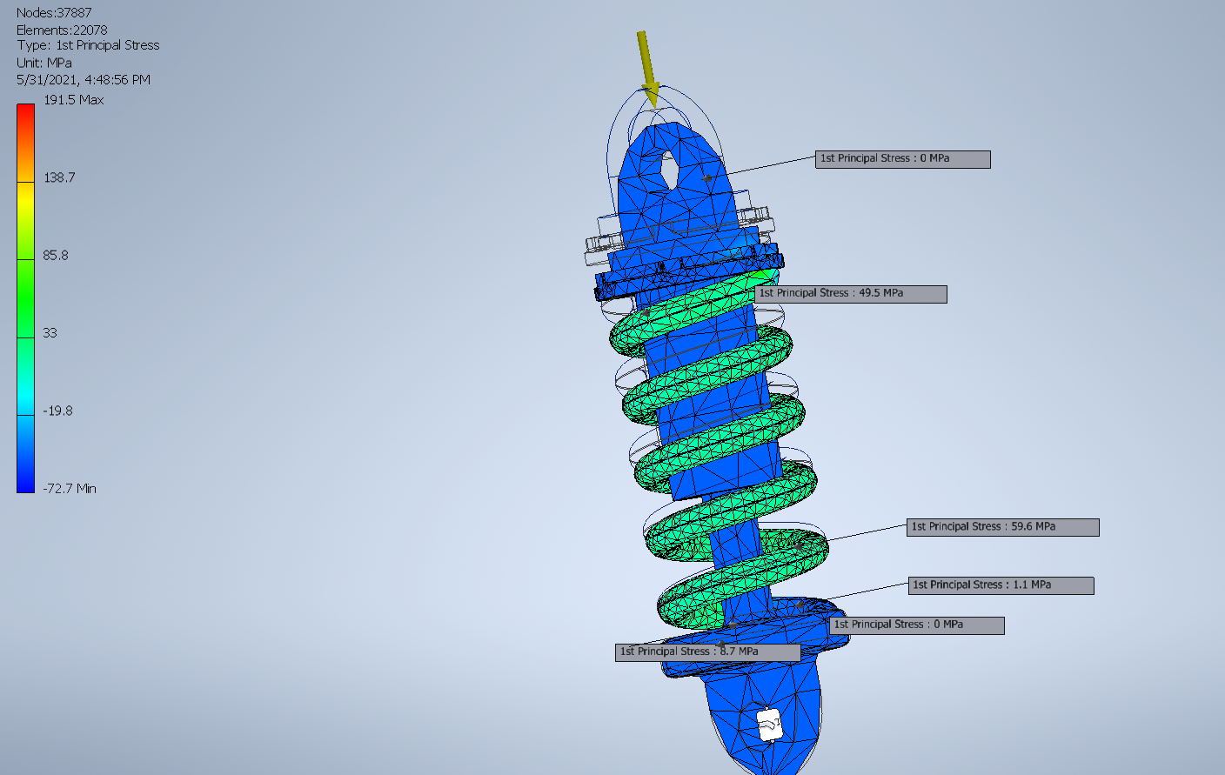
Software used: Autodesk Inventor- Stress Analysis (1st Principal Stress).

Slide 20
Software used: Autodesk Inventor- Stress Analysis (1st Principal Stress).
The 1st principal stress gives you the value of stress that is normal to the plane in which the shear stress is zero. The 1st principal stress helps you understand the maximum tensile stress induced in the part due to the loading conditions.

Slide 21
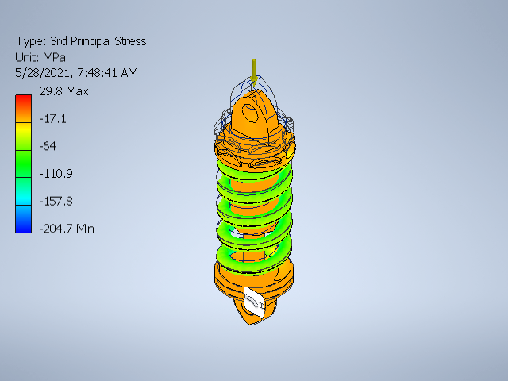
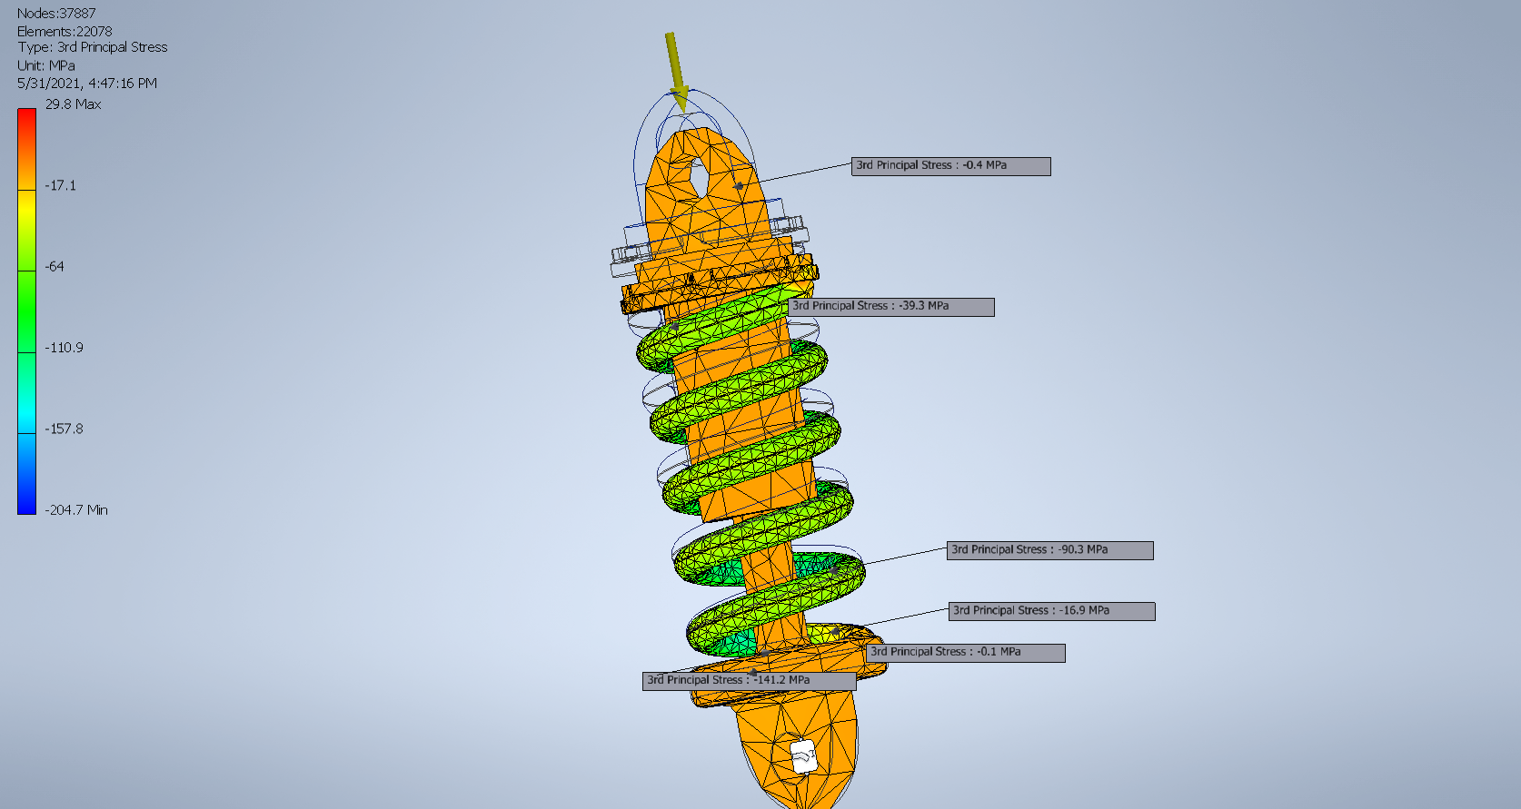
Software used: Autodesk Inventor- Stress Analysis (3rd Principal Stress).

Slide 22
Software used: Autodesk Inventor- Stress Analysis (3rd Principal Stress).
The 3rd principal stress acts normal to the plane in which shear stress is zero. It helps you understand the maximum compressive stress induced in the part due to the loading conditions.

Slide 23
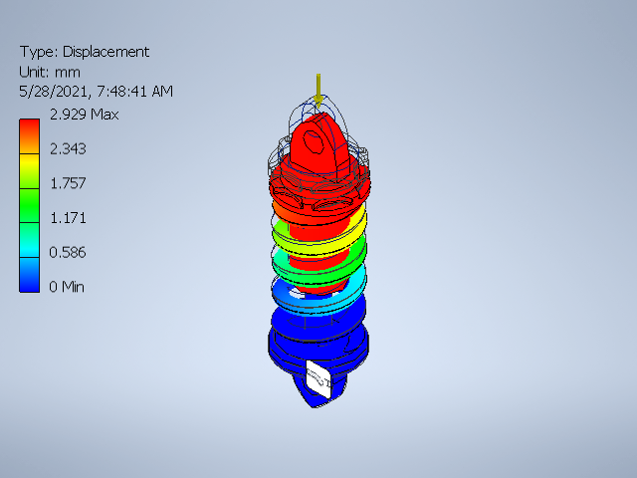
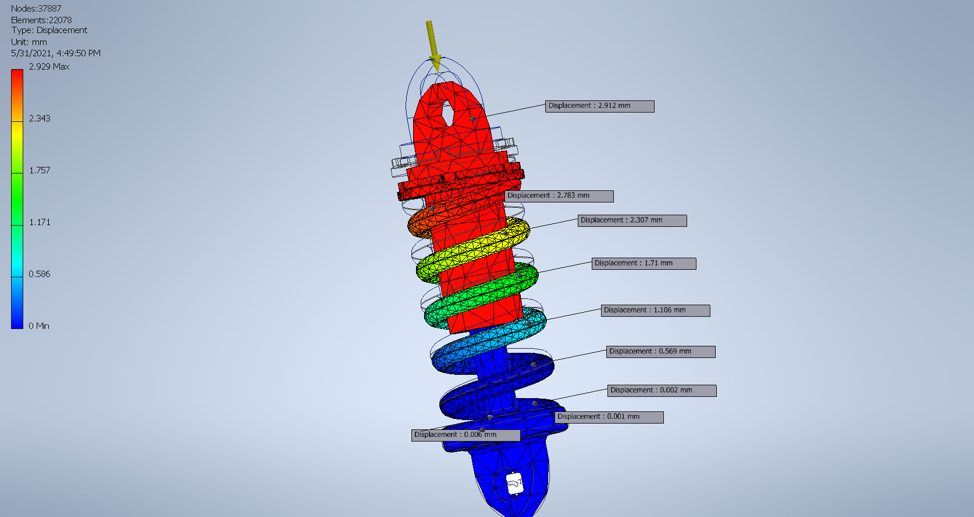
Software used: Autodesk Inventor- Stress Analysis (Displacement).
This is how much the component deflects by, i.e. how much displacement our component has undergone.

Slide 24
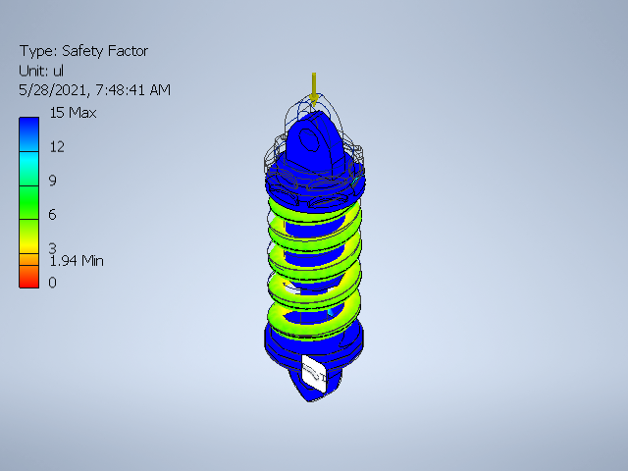
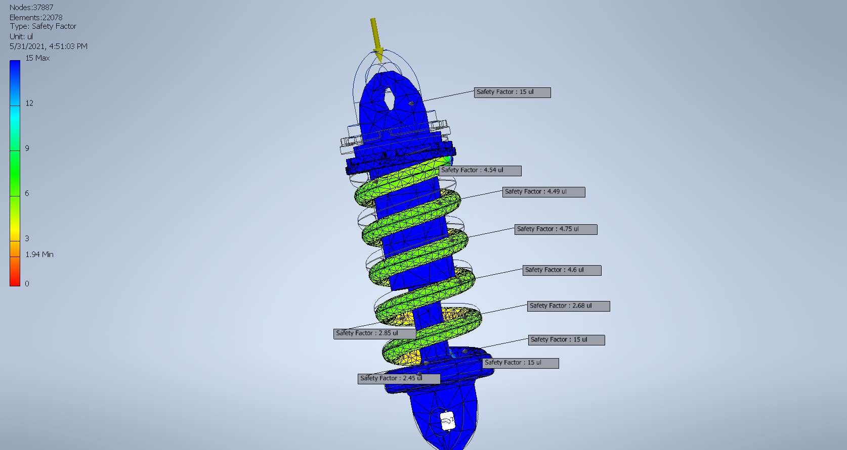
Software used: Autodesk Inventor- Stress Analysis (Safety Factor).

Slide 25
Design of a Mechanical System.
Thank you and have a lovely evening!

